Slide 1
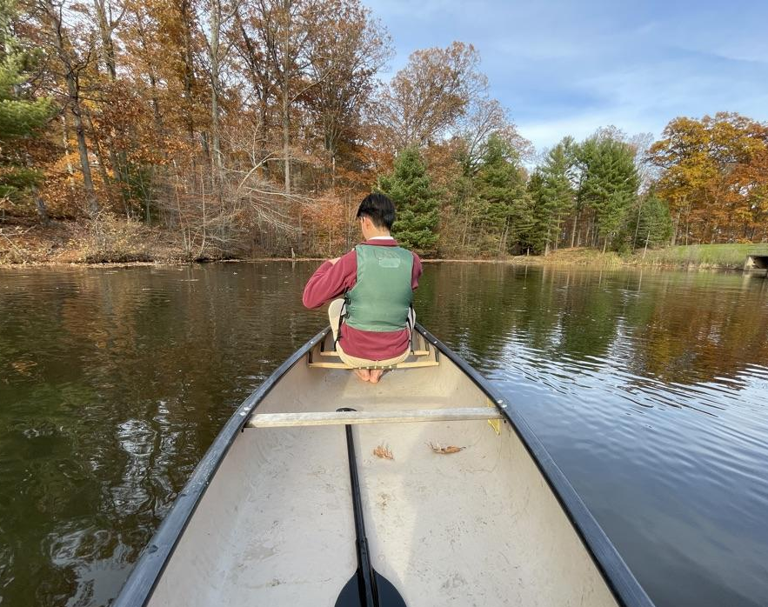
Strnad Presentation: Lake Kilroy Buoy and Water Quality Project
Sam Mathews and Vir Patel

Slide 2



Overview
Buoy
Water Quality
Data/Research

Slide 3
Buoy
Create a buoy to float on Lake Kilroy
House 2 water quality sensor units at different depths + ESP32 hardware + solar panel

Slide 4

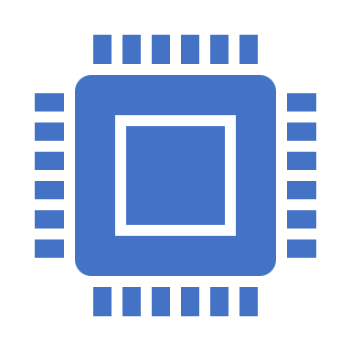
Water Quality
Use a sensor unit to measure pH, dissolved oxygen, conductivity, and temperature using an Atlas Scientific kit
Use ESP32 chips to collect the data and upload the data to ThingSpeak so anyone who wants to can have access to the data

Slide 5
Data/Research
Use the data to observe pond turnover in Lake Kilroy

Slide 6
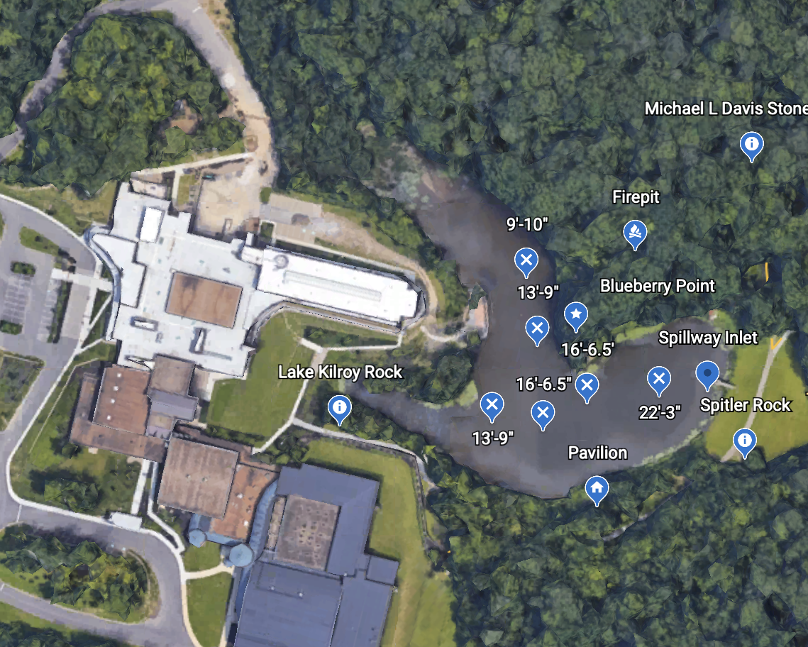
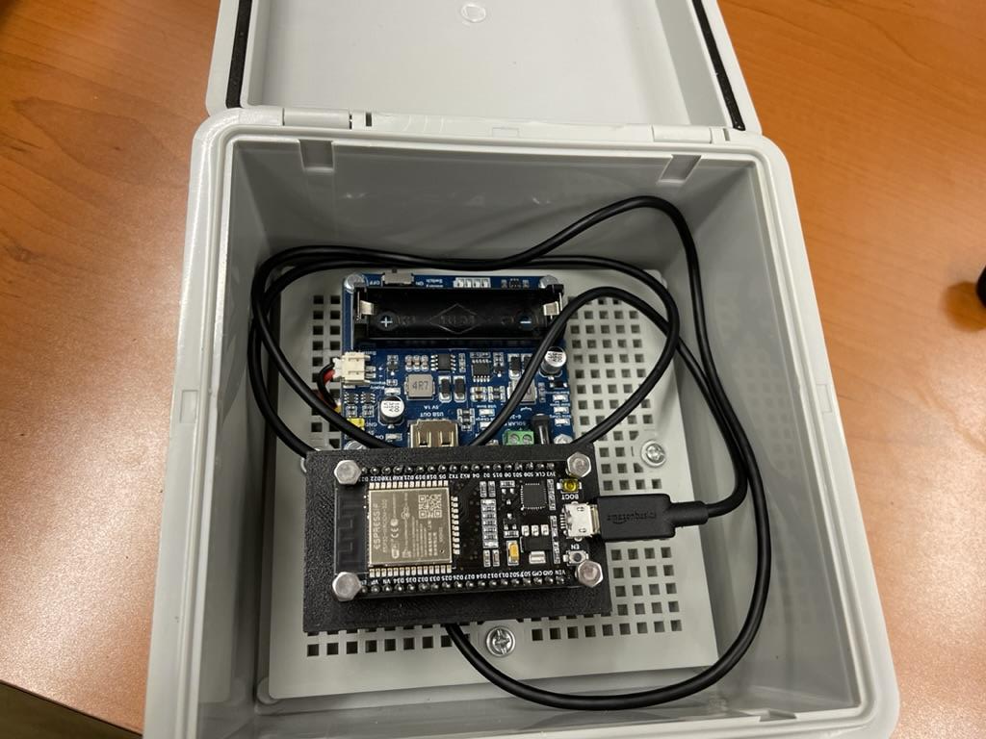
General Tasks and Work
We have also established where we will place the buoy (we found the deepest part of Lake Kilroy, so we can get two distinct depths)
We have also construed a contraption to house the ESP32 and measured its range, so we know where to place them

Slide 7
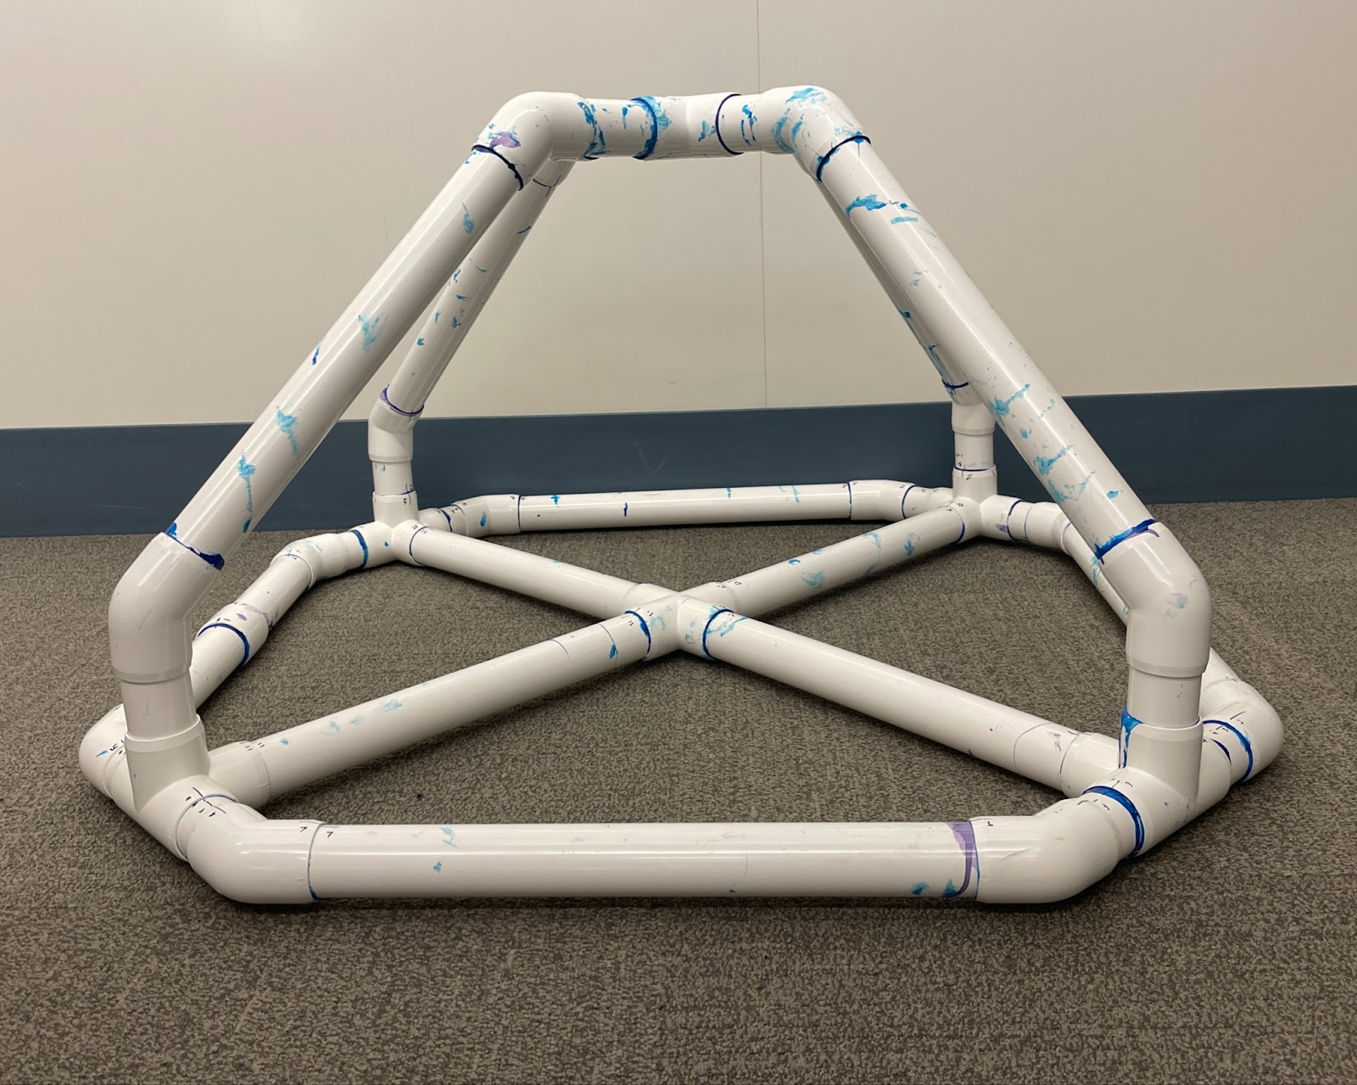
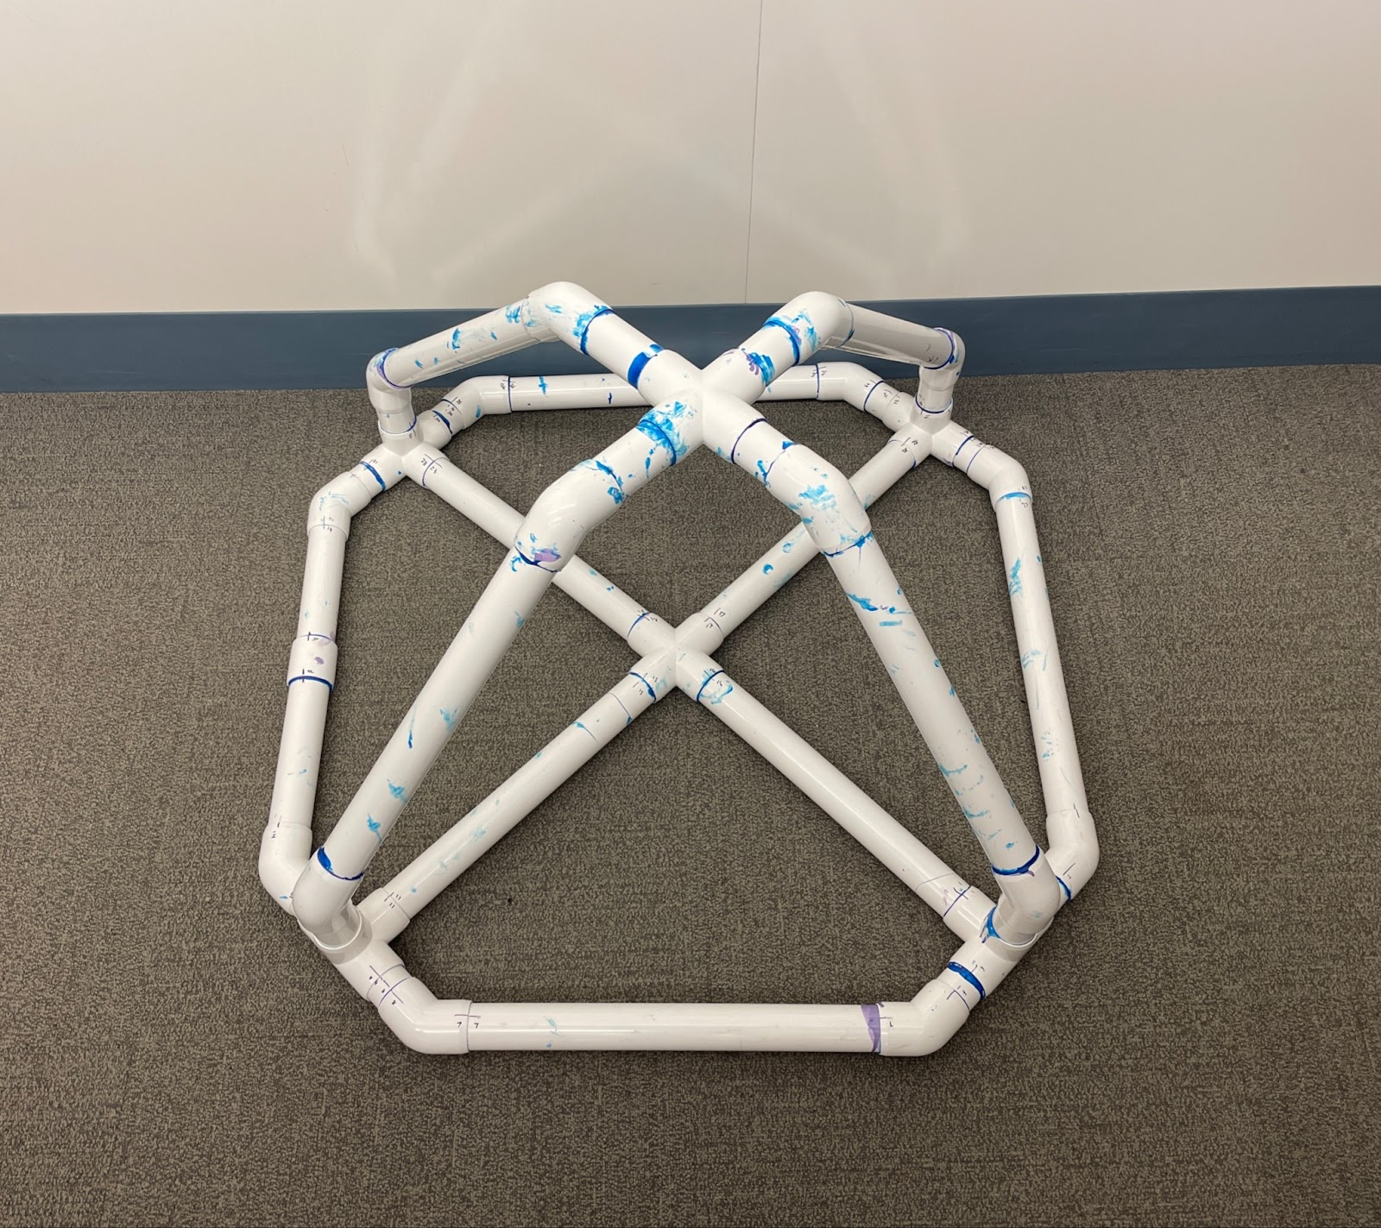
Buoy
This is the construction of the buoy out of PVC pipes
At this point the top and bottom halves are glued separately

Slide 8
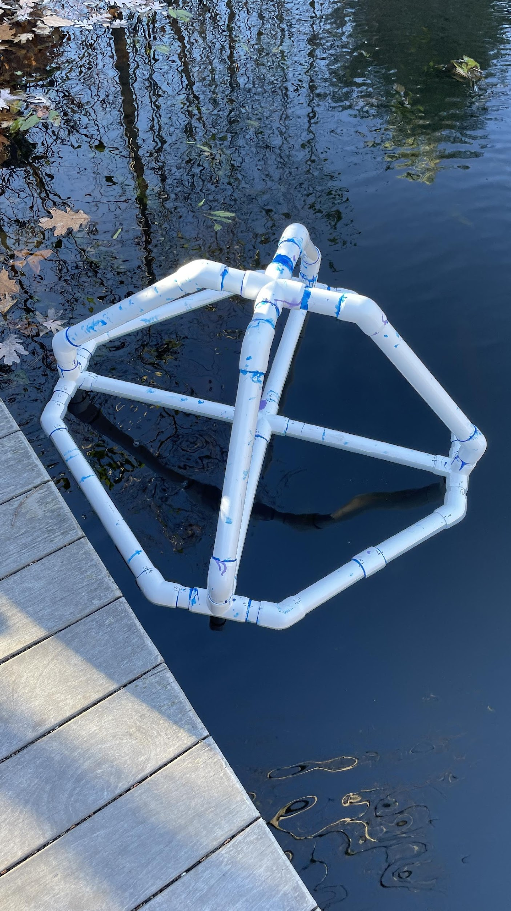
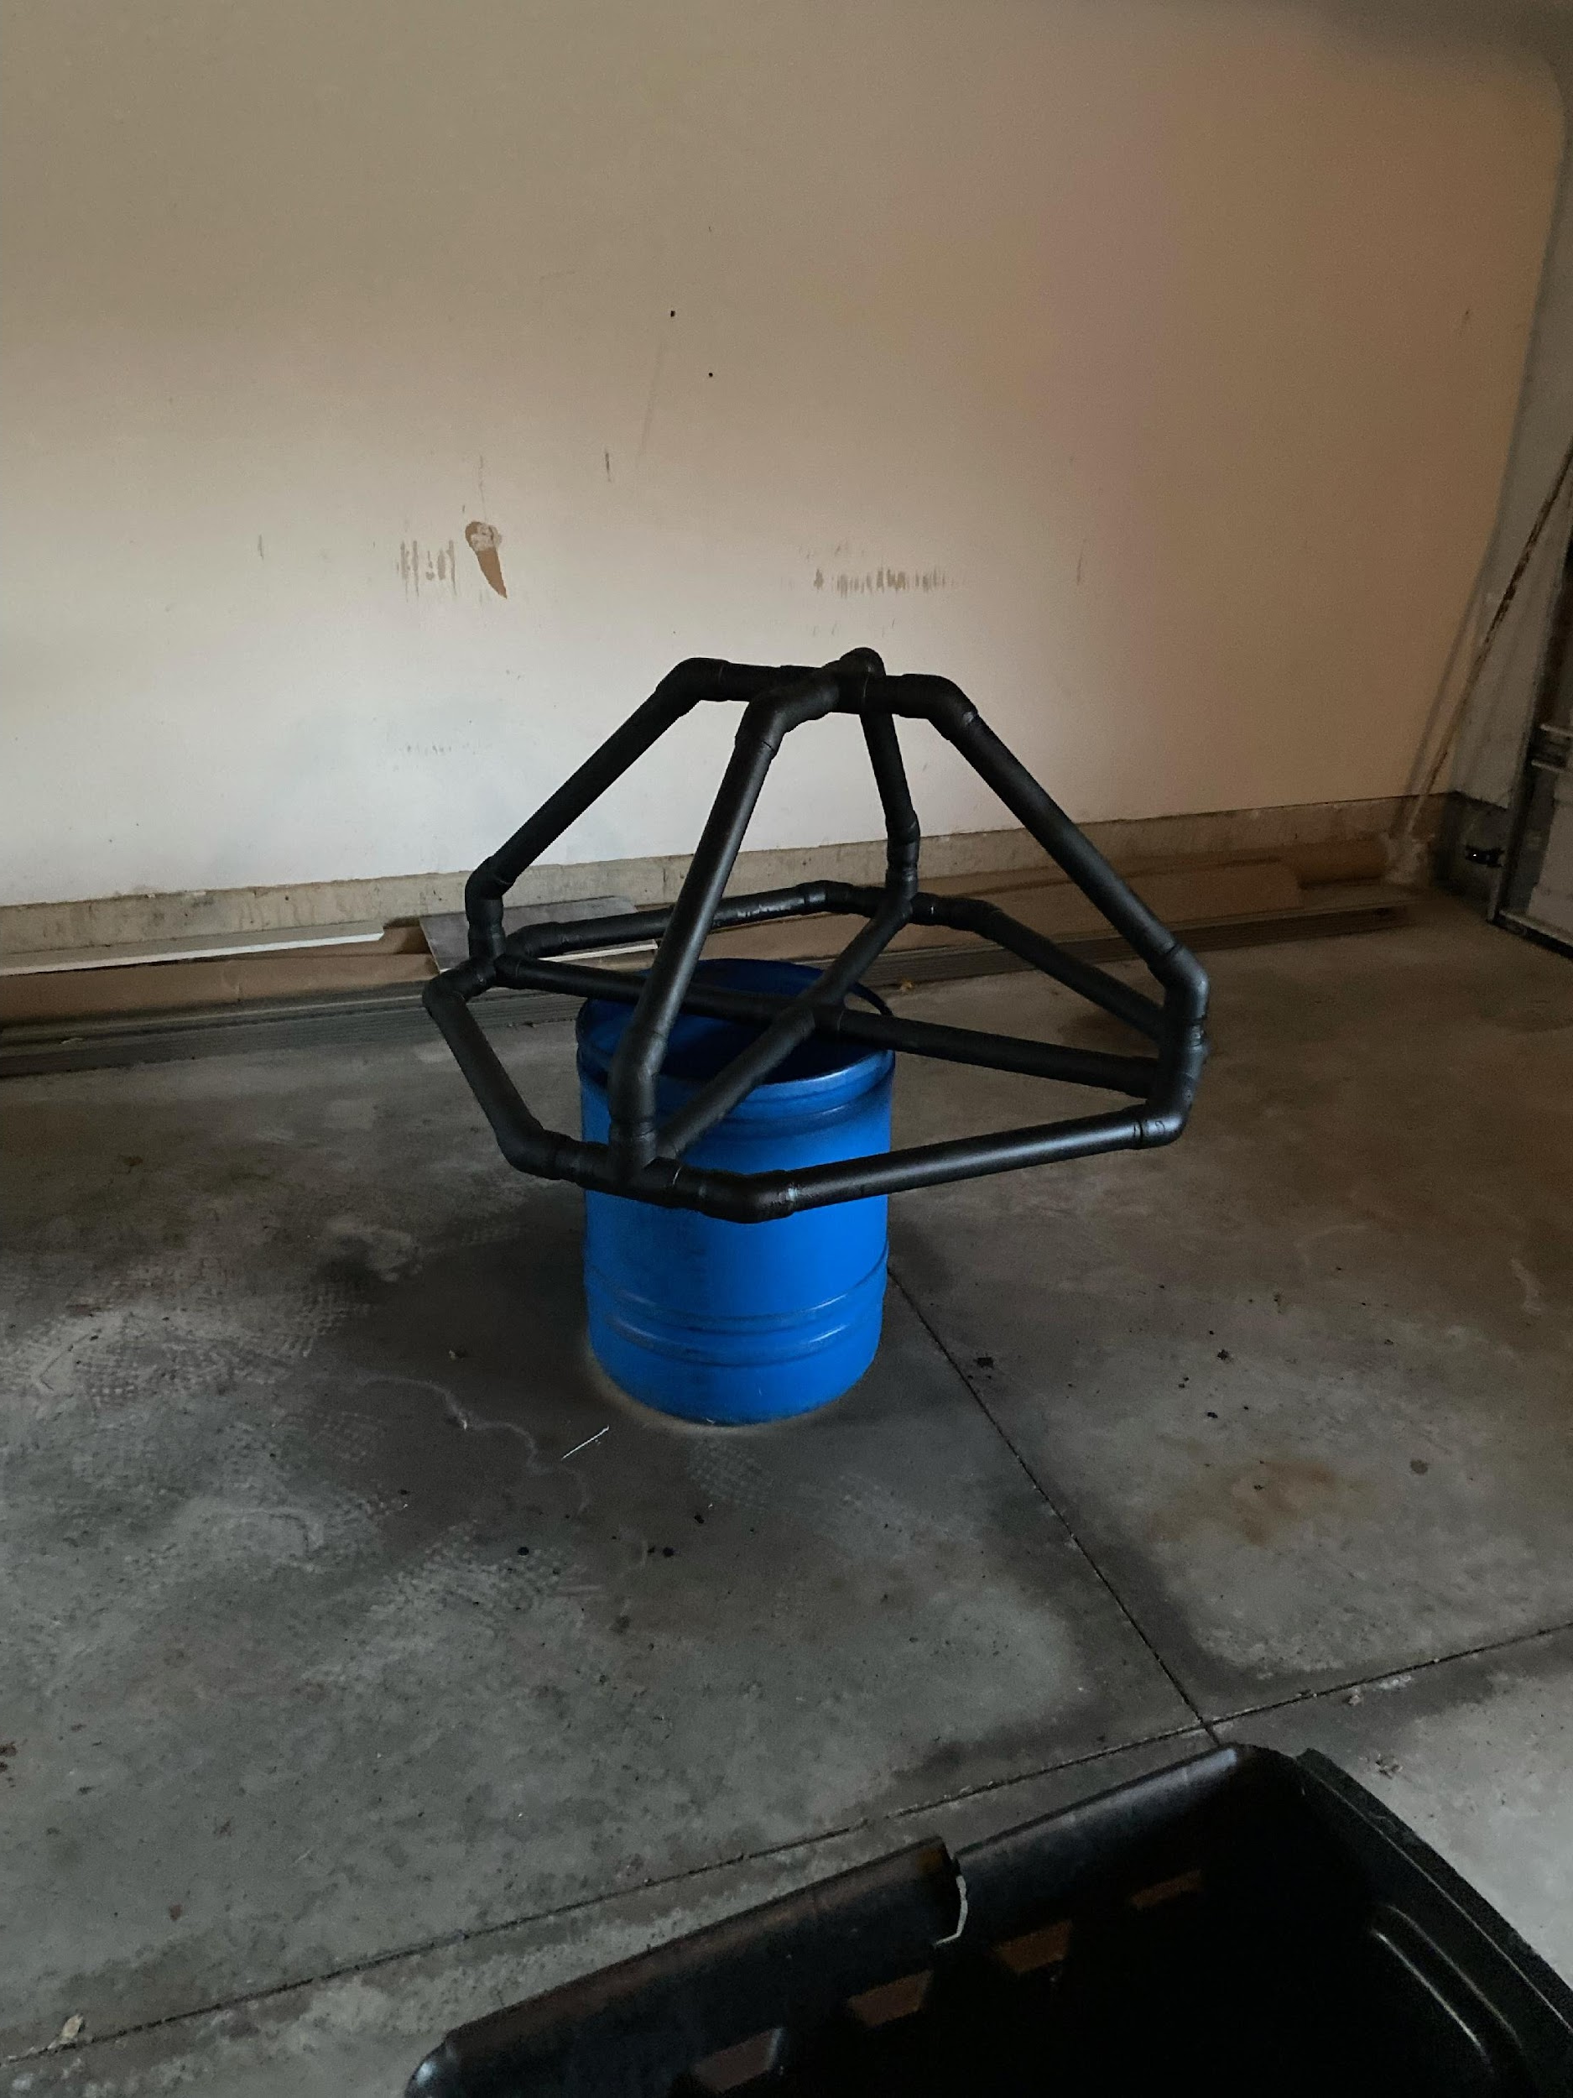
Pictures of Buoy Floating/Spray Paint
Now the buoy is completely glued together
It has a black coated paint
It can also float

Slide 9
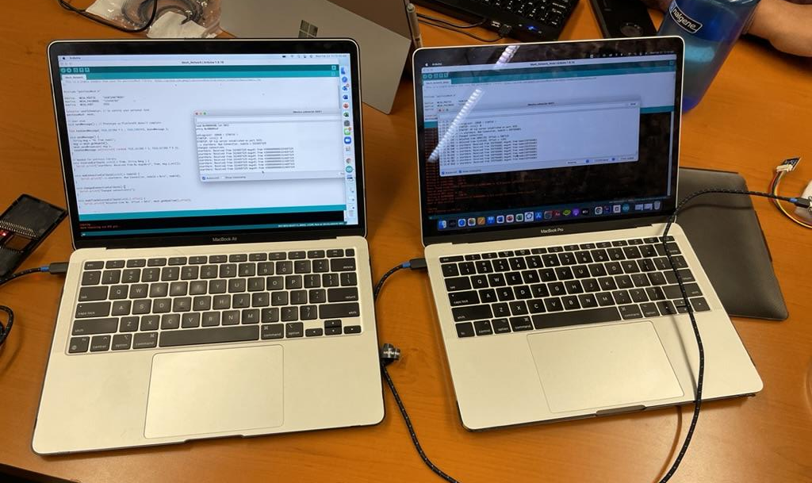
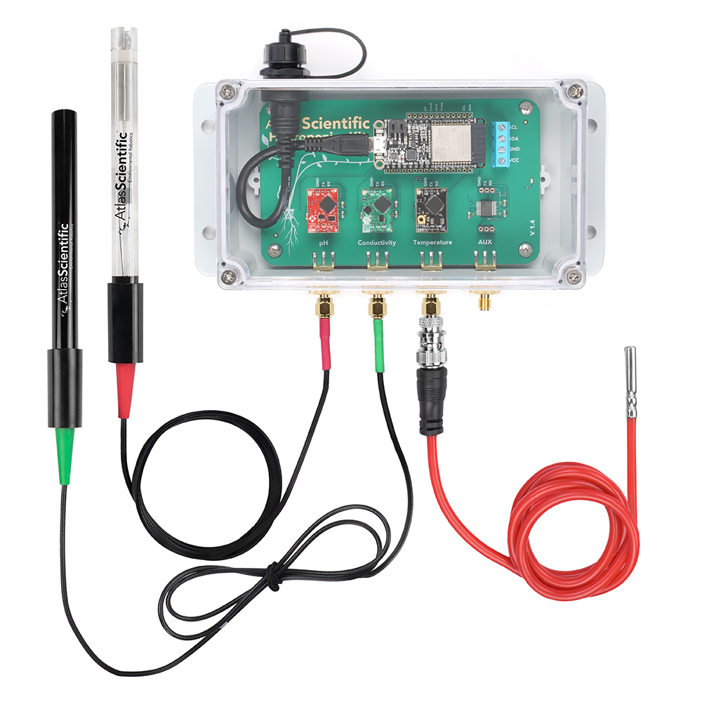
Coding and Water Quality
We have the sensor unit, which is essentially all we needed
It has all of the probes for pH, dissolved oxygen, conductivity, and temperature
This is where we have gotten stuck the most
Our coding consists of three phases
1) Meshnetwork
2) MQTT
3) Antenna/Long distance

Slide 10
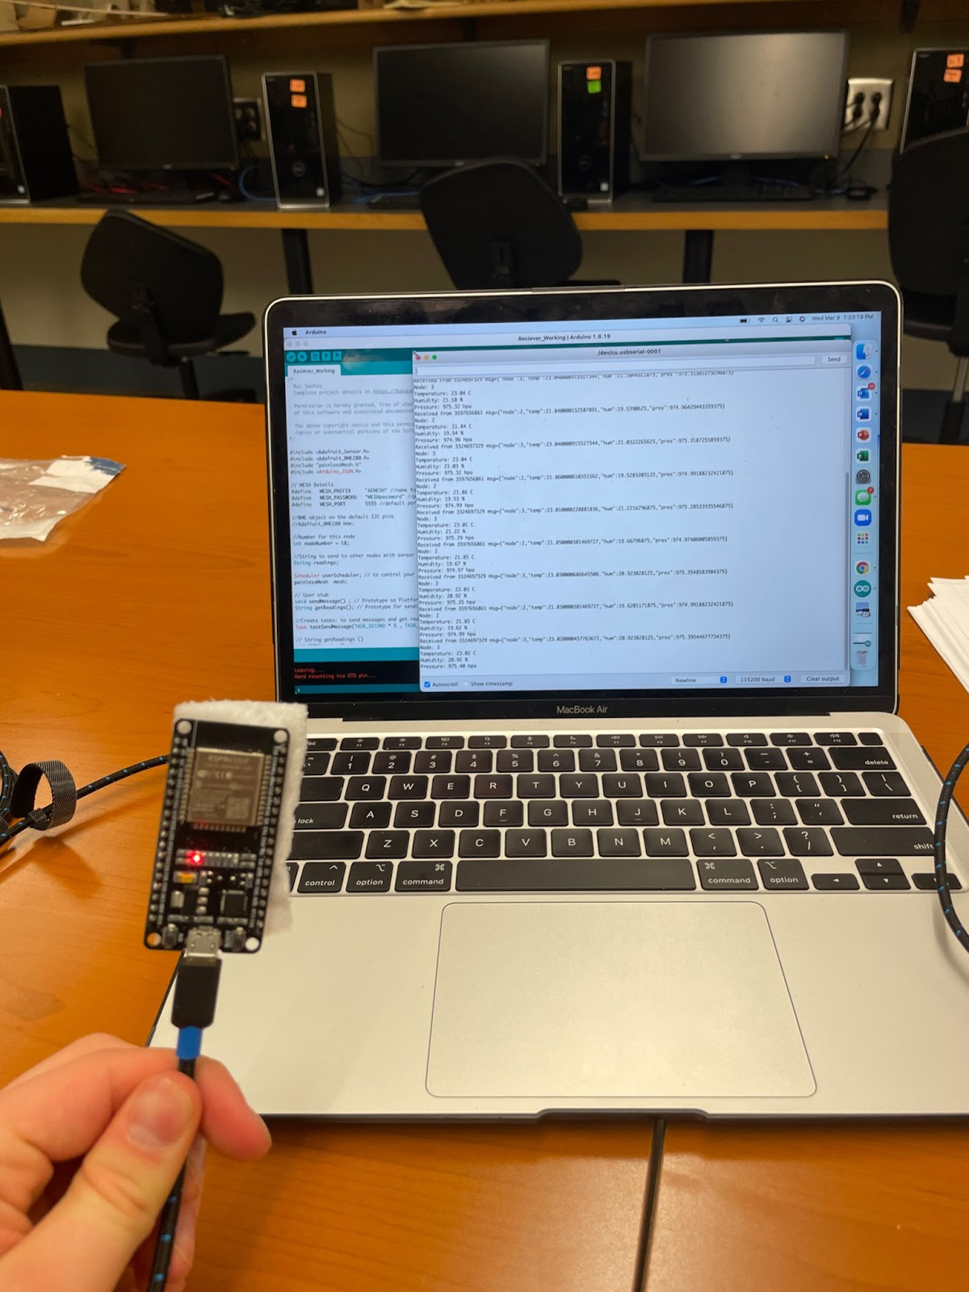
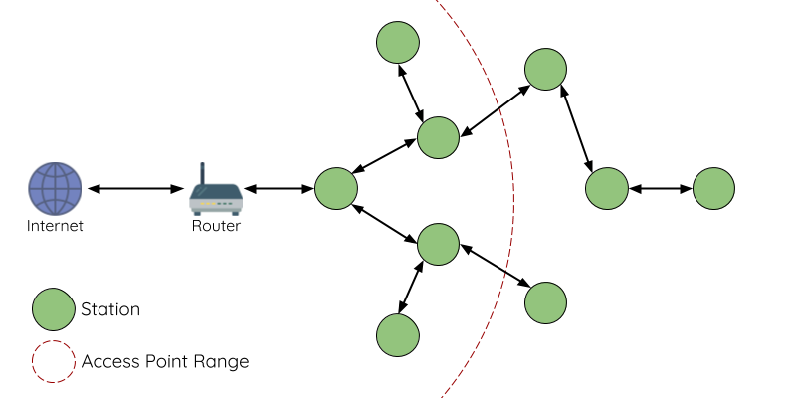
Coding Meshnetwork
Our first goal was to create a meshnetwork amongst ESP32 chips to upload to Thingspeak
A meshnetwork is a Bluetooth connection among chips so they can communicate

Slide 11
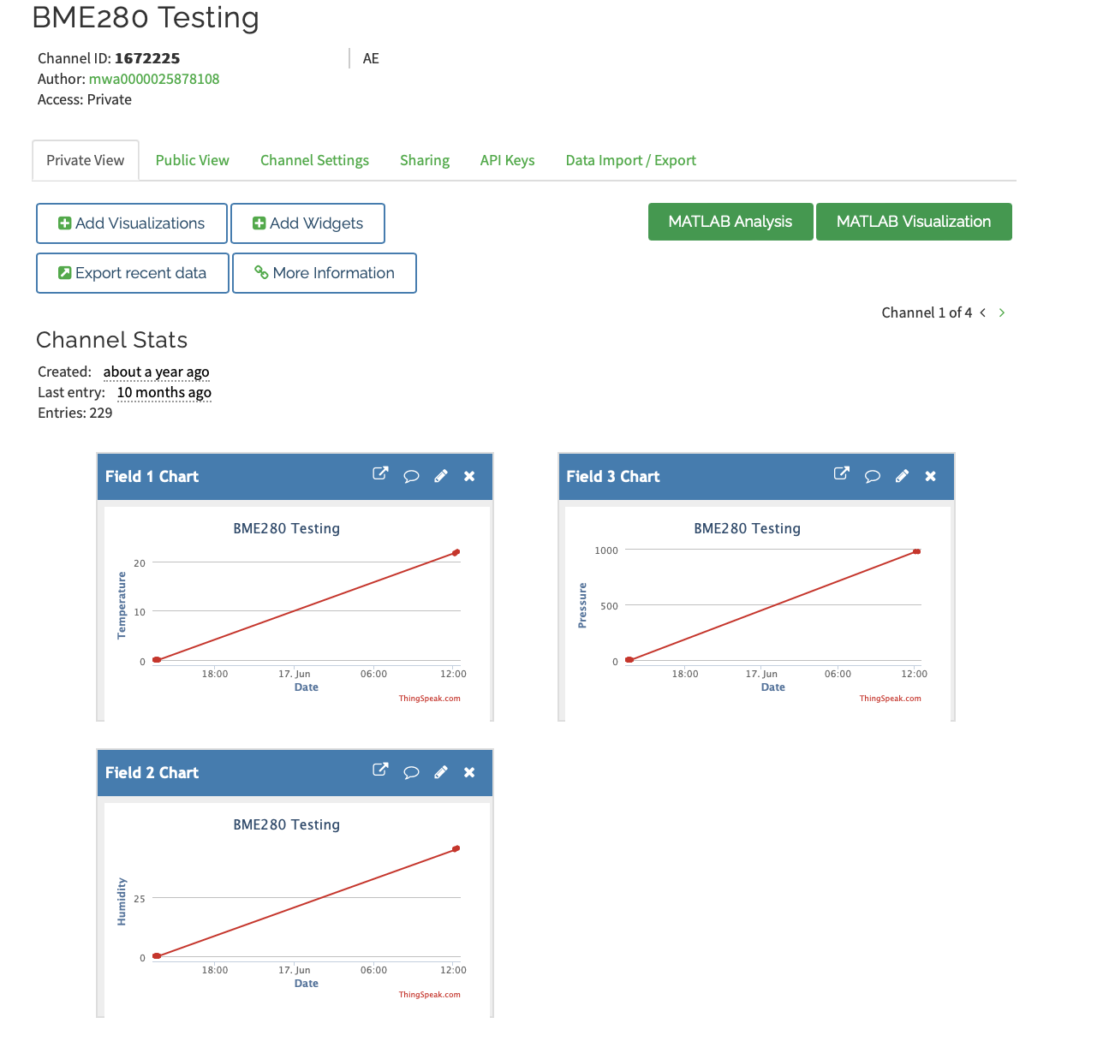
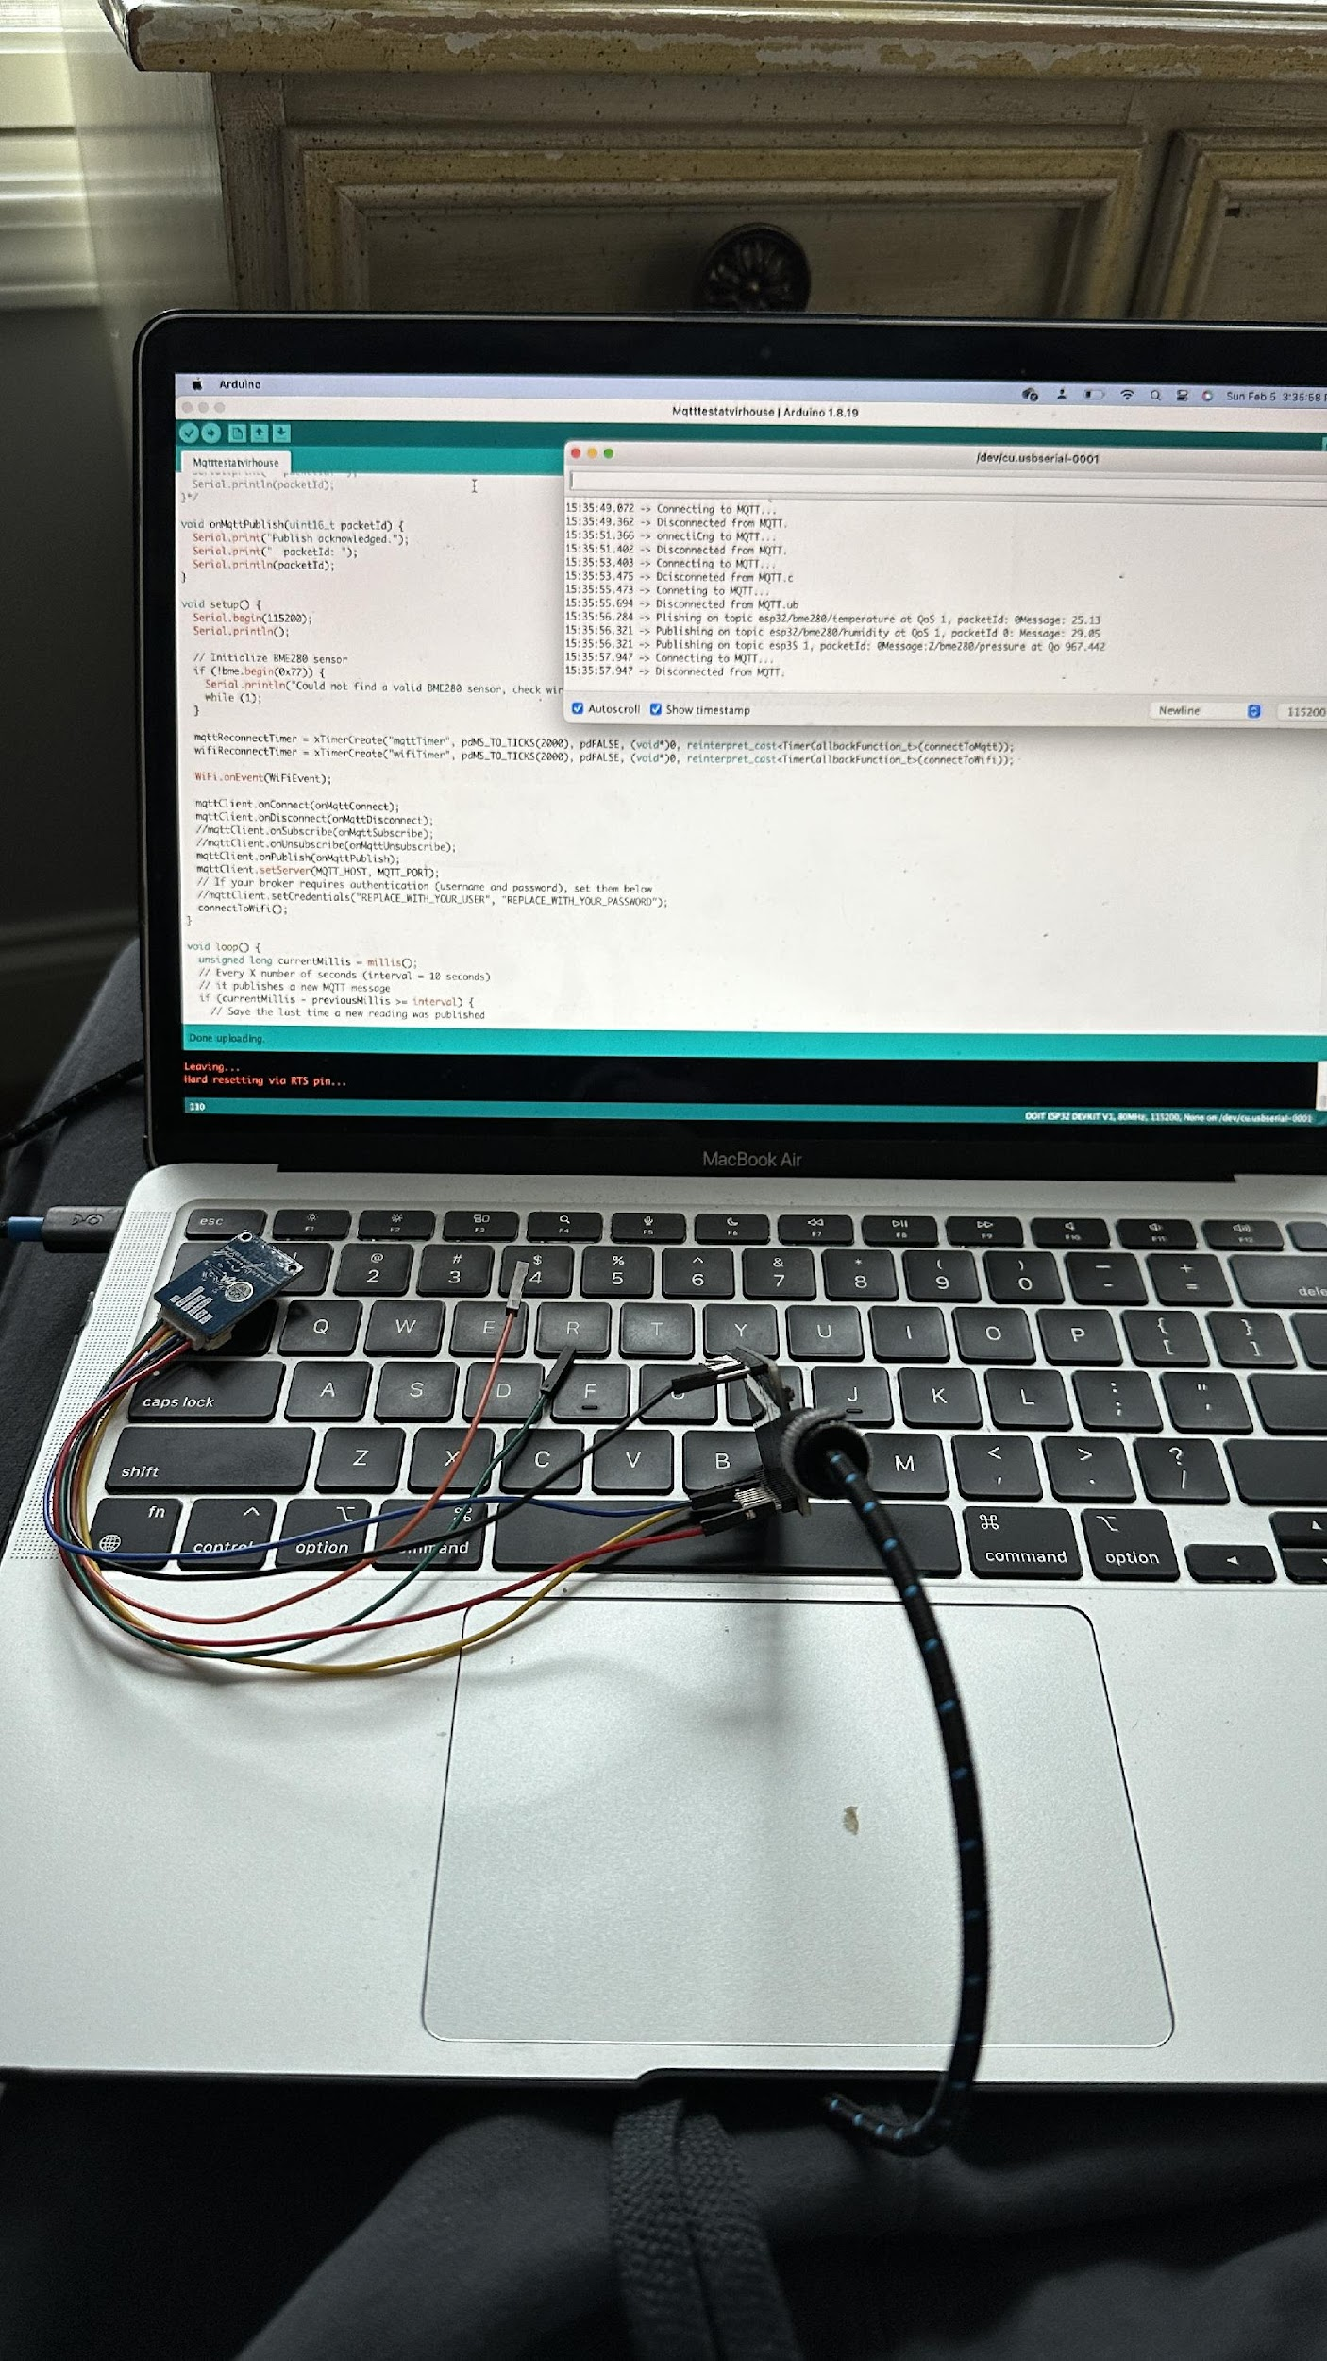
Coding Meshnetwork
We were able to establish a stable connection to ThingSpeak from an ESP32 and upload data
We were also able to create a mesh netwwork between ESP32 chips
However there was a timing problem with the meshnetwork and ThingSpeak code since they used different timers

Slide 12
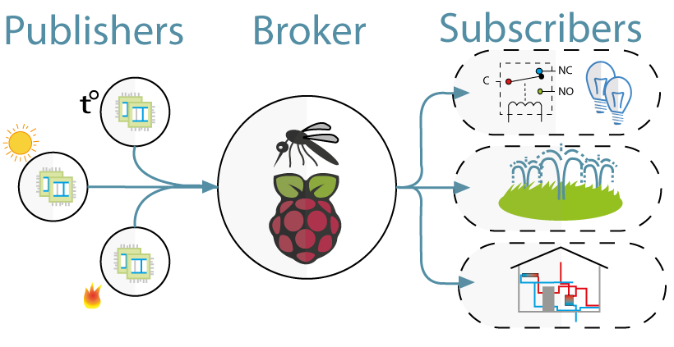
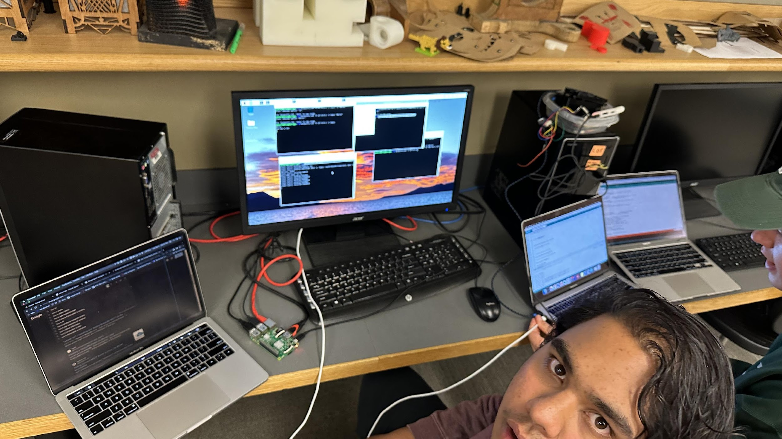
Transition to Raspberry Pi + MQTT
Next we turned to a Raspberry Pi MQTT with Mosquitto
Essentially, the Raspberry Pi was a broker where the ESP32 could send data and ThingSpeak could subscribe to collect the data
We could not find enough code to make this work

Slide 13
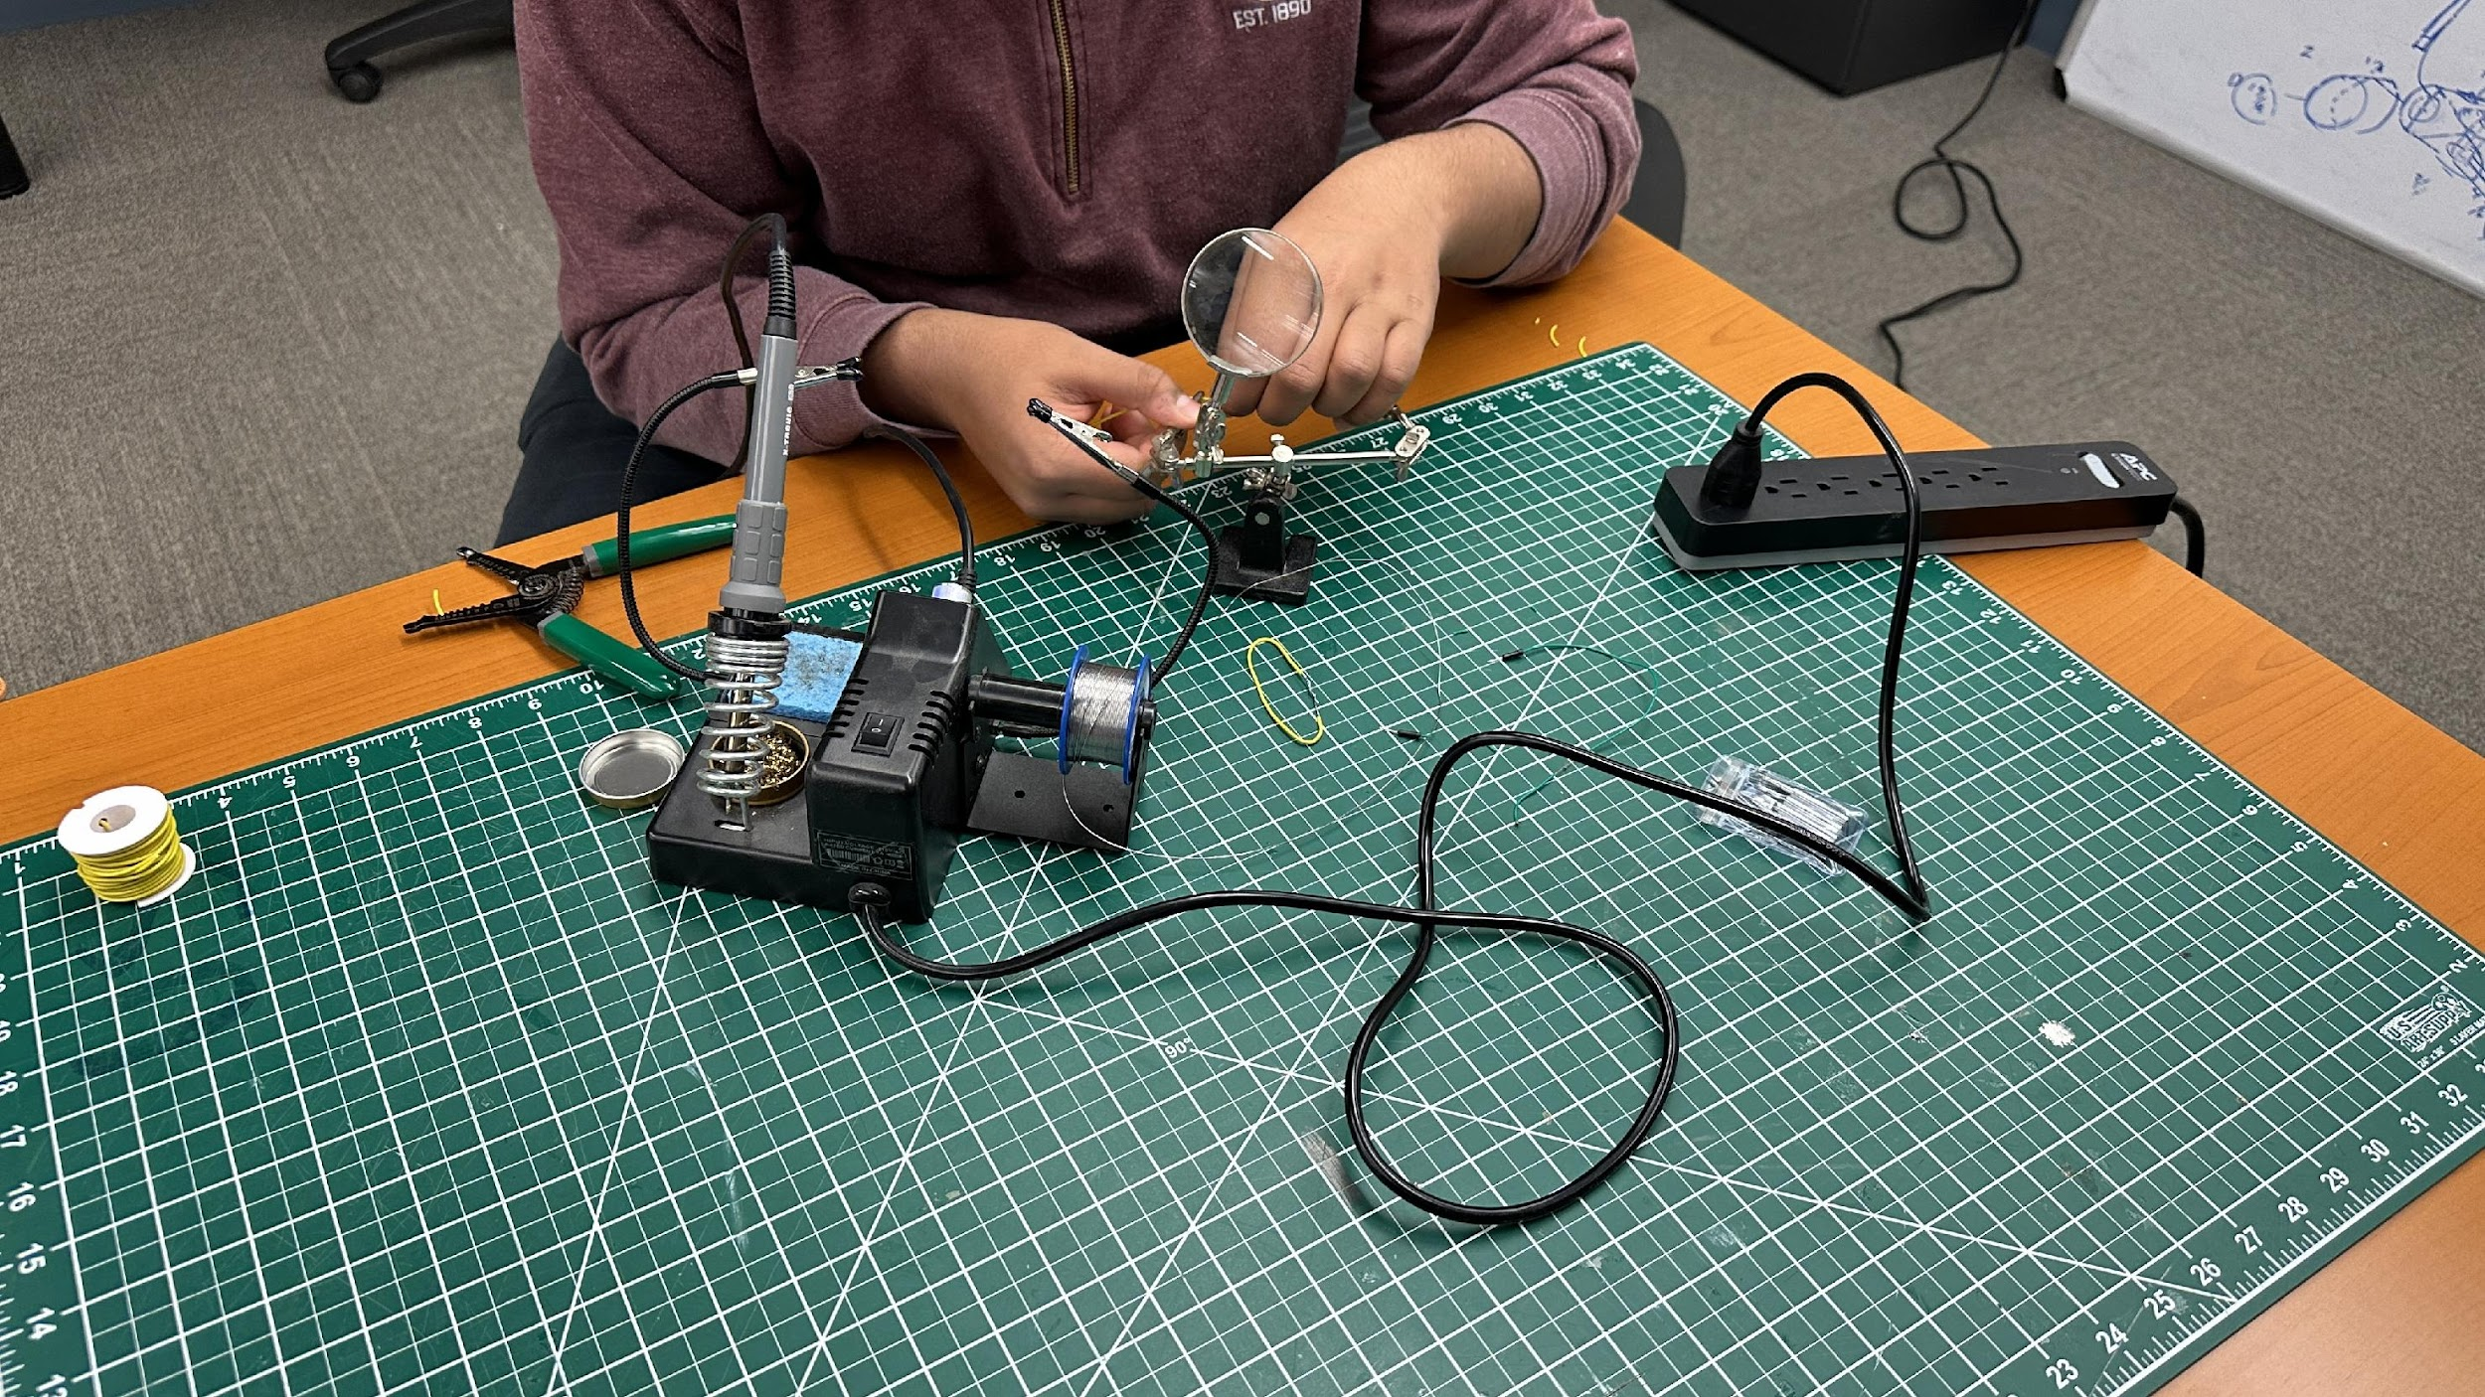
Code Antenna
Now we are going to add an antenna to the ESP32 to enhance its range
This way we can directly upload to ThingSpeak without a meshnetwork or MQTT

Slide 14
Next Year
Vir will continue this project next year with data research and completion of the buoy

Slide 15
Thanks

